Slide 1
BUS ARBITRATION

Slide 2
BUS ARBITRATION
Bus Arbitration refers to the process by which the current bus master accesses and then leaves the control of the bus and passes it to another bus requesting processor unit.
The controller that has access to a bus at an instance is known as a Bus master.
A conflict may arise if the number of DMA controllers or other controllers or processors try to access the common bus at the same time, but access can be given to only one of those. Only one processor or controller can be Bus master at the same point in time. To resolve these conflicts, the Bus Arbitration procedure is implemented to coordinate the activities of all devices requesting memory transfers. The selection of the bus master must take into account the needs of various devices by establishing a priority system for gaining access to the bus.
The Bus Arbiter decides who would become the current bus master.

Slide 3
BUS ARBITRATION
There are two approaches to bus arbitration:
Centralized bus arbitration –
A single bus arbiter performs the required arbitration.
2. Distributed bus arbitration –
All devices participating in the selection of the next bus master.

Slide 4
METHODS OF CENTRALIZED BUS ARBITRATION:
There are three bus arbitration methods:
Daisy Chaining method
Polling or Rotating Priority method
Fixed priority or Independent Request method

Slide 5
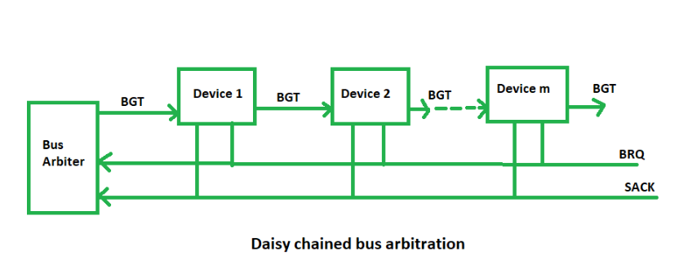
DAISY CHAINING METHOD
It is a simple and cheaper method where all the bus masters use the same line for making bus requests.
The bus grant signal serially propagates through each master until it encounters the first one that is requesting access to the bus.
This master blocks the propagation of the bus grant signal, therefore any other requesting module will not receive the grant signal and hence cannot access the bus.
During any bus cycle, the bus master may be any device – the processor or any DMA controller unit, connected to the bus.

Slide 6
DAISY CHAINING METHOD
Advantages:
Simplicity and Scalability.
The user can add more devices anywhere along the chain, up to a certain maximum value.
Disadvantages:
The value of priority assigned to a device depends on the position of the master bus.
Propagation delay arises in this method.
If one device fails then the entire system will stop working.

Slide 7
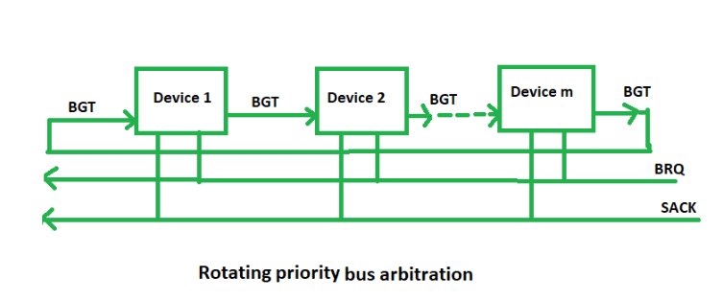
POLLING OR ROTATING PRIORITY METHOD
In this, the controller is used to generate the address for the master(unique priority), the number of address lines required depends on the number of masters connected in the system.
The controller generates a sequence of master addresses.
When the requesting master recognizes its address, it activates the busy line and begins to use the bus.

Slide 8
POLLING OR ROTATING PRIORITY METHOD
Advantages –
This method does not favor any particular device and processor.
The method is also quite simple.
Disadvantages –
Adding bus masters is difficult as increases the number of address lines of the circuit.
If one device fails then the entire system will not stop working.

Slide 9
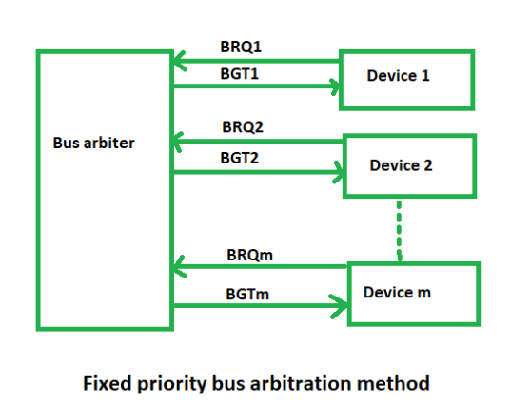
FIXED PRIORITY OR INDEPENDENT REQUEST METHOD
In this, each master has a separate pair of bus request and bus grant lines and each pair has a priority assigned to it.
The built-in priority decoder within the controller selects the highest priority request and asserts the corresponding bus grant signal.

Slide 10
FIXED PRIORITY OR INDEPENDENT REQUEST METHOD
Advantages –
This method generates a fast response.
Disadvantages –
Hardware cost is high as a large no. of control lines is required.

Slide 11
DISTRIBUTED BUS ARBITRATION
In this, all devices participate in the selection of the next bus master. Each device on the bus is assigned a 4bit identification number. The priority of the device will be determined by the generated ID.

